Slide 1
React vs Angular JS
Haoyuan Yue

Slide 2
Library vs Framework
Library is a collection of functions which are useful when writing web apps, your code is in charge and it calls into the library when it sees fit.
Framework is a particular implementation of a web application, where your code fills in the details, it is in charge and calls into your code when it needs something app specific.

Slide 3
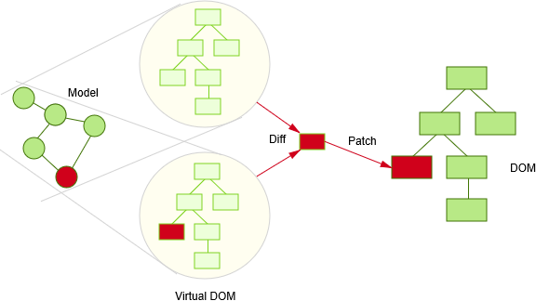
React
React is component-based, each component that manages their own state and then composes them to make complex UIs, React will efficiently update and render just the right components when your data changes, which is achieved by virtual DOM tree.

Slide 4
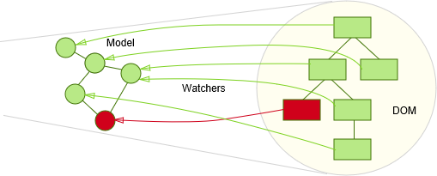
Angular JS
Angular JS is modularity, NgModules (Angular modules) consolidate components, directives, and pipes into cohesive blocks of functionality.
In view layer, it uses ‘watcher’ for rendering.

Slide 5
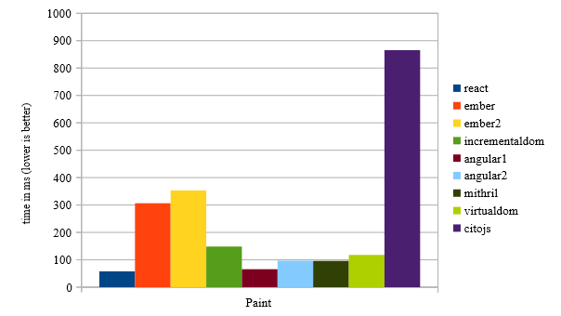
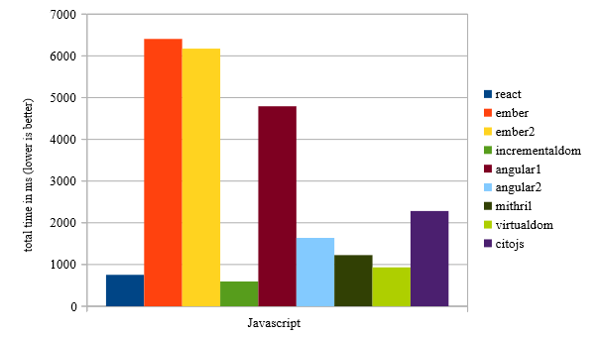
Efficiency

Slide 6



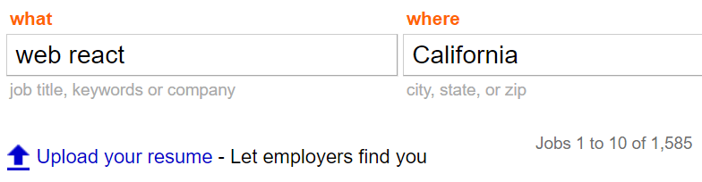

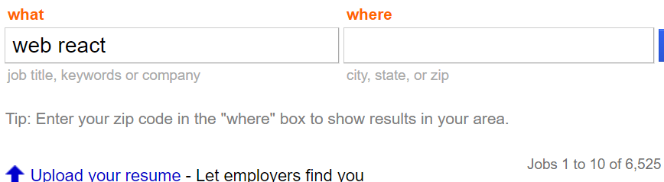
Demand & Community

Slide 7
Conclusion
React has a smoother learning curve than Angular JS and is more flexible.
Angular JS 2 has successfully solved its performance issue but still can’t beat React.
React is losing its advantage and more and more companies began seeking Angular JS developer.

Slide 8
Q & A

